Slide 1
Illinois Pension Crisis: Evaluation and Proposed Solutions
Doug Palzer, Luke Hamilton, Michael Sherman, Sebastian Vermaas

Slide 2
Goals
Evaluate the current funding crisis and weigh potential solutions
Discuss the effects of
1. Underfunding and lack of contributions
2. Improper valuations and actuarial assumptions
Recent policy measures to attempt a resurge in funding
Public Acts 96-0899, 96-1495, 98-0622, 98-0599
Propose solutions given current budgetary issues and political environment

Slide 3
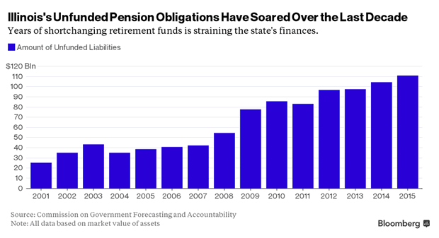
Debt Burden
Illinois has a long-standing history of underfunding its pension programs
Lack of contributions has resulted in an actuarial accrued liability of $111 billion
Per taxpayer: $45,000
Funding ratio of <40%
Notes:
http://static.safehaven.com/authors/mish/39971.png

Slide 4
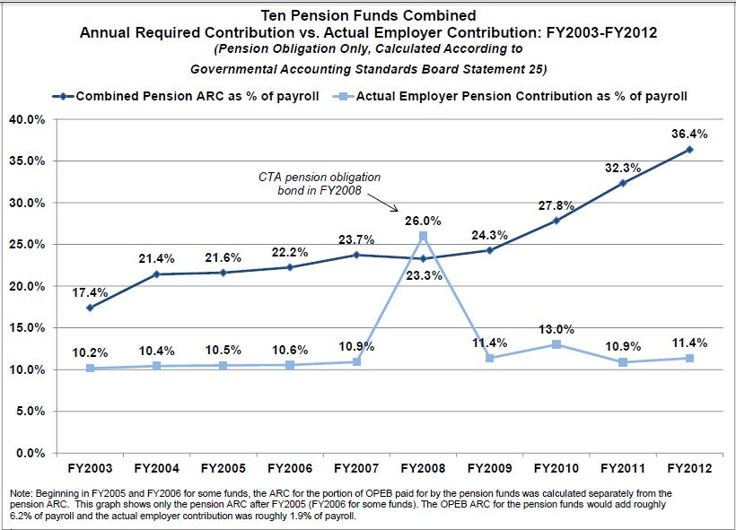
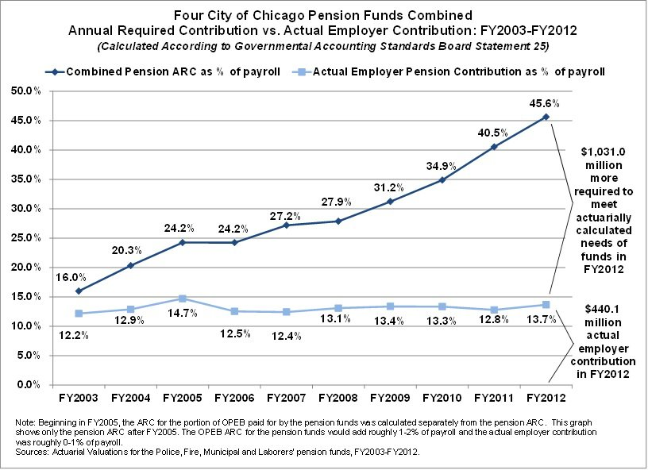
Actuarial Required Contribution
Unlike relatively well-funded states, Illinois has not adhered to a sound ARC
Illinois
Chicago

Slide 5
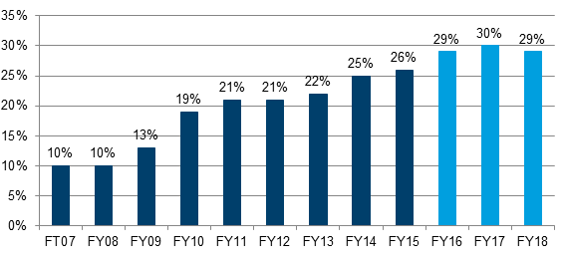
Pension Obligations as % of Revenue
Growing ARC will impair the ability to fund ‘Essential State Services’
As a result, the State is forced to cut back on other services.

Slide 6
Advantages of GASB 67, 68
Holds state and local governments to more accurate representations of actuarial valuations
Clearer picture of the State’s fiduciary net position
Allows for more comprehensive measure of cost/benefit analysis
Notes:
https://www.illinoispolicy.org/pension-funds%C2%92-expected-rates-of-return-%C2%93biggest-lie-in-global-finance%C2%94/

Slide 7
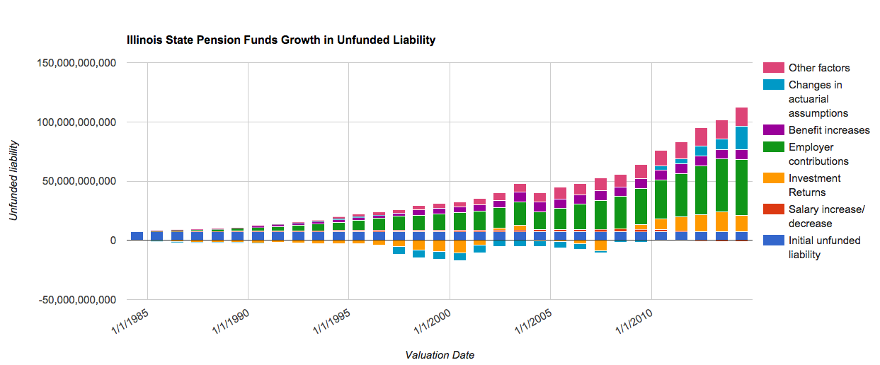
The two biggest factors contributing the growth in Unfunded Liability: Poor contributions and poor investment returns

Slide 8
Contributions
The State has failed to contribute equal to any accurate ARC or properly account for growth in Unfunded Liabilities
Granted, the State also does not have strong ability to generate higher income
Therefore, it is principally in the hands of state actuaries and fund managers to make up for the increasing liability- by means of over reporting assets or assuming unrealistic returns

Slide 9
ARC cont.
Factors that contribute to the Actuarial Required Contribution
1. Benefit Accruals
2. Benefit Withdrawals
3. Mortality
4. Return on Assets
5. Entitlements (Multiplier)
6. Employer Contribution Schedule
7. Employee Contribution Schedule

Slide 10
Return on Assets
Investment Returns do perform relatively well, but recessionary times are not accounted for in current straight-line method
Six sigma crises happen much more often than in previous centuries
Specifically, the financial crisis of 2008 changed the way we must think about computing our ROA assumptions
Evaluate systemic risk inherent in liquidation of major state assets

Slide 11
Solution Options
Increase Taxes
Cut Spending
Move new workers to a defined contribution plan
Moving all workers to a DC plan
Cut Benefits
Raise contributions

Slide 12
Viable Solutions
Attempts have been made to move new workers into a defined contribution plan
Tier I and Tier II Programs
Only danger may be less employee contributions into current fund, drastically impairing the ability to pay off the unfunded liability
Raise Taxes
Return to 5% flat income tax
May result in further outflows from Illinois

Slide 13
Amendment Proposal
Our proposal attempts to meet bipartisan lines while also offering a path to solvency
1. Implement a Progressive Tax (2-7%) that will increase State revenues sufficiently to pay the unfunded liability
2. Redefine the Pension Benefit Clause of the Illinois State Constitution, in order to readjust COLA’s accurately to inflation
3. Add Term Limits to the General Assembly

Slide 14
The ‘Bankruptcy Clause’
“The Proceeding to Protect Essential State Actions”
Add article to the Federal Bankruptcy Code
U.S. Constitution grants Congress the right to enact “uniform laws on the subject of bankruptcies throughout the United States”
Would only pertain to the insolvency of specific State pension funds
Arguments against include setting precedent for the default on other State debts
May be deemed Unconstitutional due to the Obligation of Contract clause in Article 1, Section 10, clause 1
“No state shall pass any Law impairing the Obligation of Contracts”

Slide 15
Public Act 98-0599
Passage of such an amendment would allow for the implementation of pension reform plans such as Public Act 98-0599
This would allow for plans that renegotiate current pension benefits in order to return to healthy funded ratios within 50 years
Would allow for the placement of salary caps to reduce long term liabilities
Arguments against include moral obligation to fulfillment of pension contracts, as well as the viability of the ‘ramp’ program
Perpetuates the issue of moving the obligation of payments toward the unfunded liability on later generations

Slide 16
Conclusion
Need for increased revenue base and decreased expenses
More transparency with respect to state fiduciary responsibility
More accurate actuarial evaluation of risk exposure (ROA, Liquidity of Assets, Impact of market saturation)
Foster greater awareness of the scope of the crisis
Garner bipartisan support for political action

Slide 17
References
The Civic Federation
Illinois Policy Institute
Truth in Accounting
Reboot Illinois
IL CAFR
Federal Reserve of Chicago
Manhattan Institute for Policy Research

