Slide 1
Illinois Pension Crisis
By: Kaitlyn O’Shea, Connor Francesca, Nealkanth Patel, Darshan Kamdar

Slide 2
Our Focus
SURS- State Universities Retirement System of Illinois
51,631 SURS currently in retirement
Average Salary of $50,103
2014 unfunded liability of $20,038,650,000

Slide 3
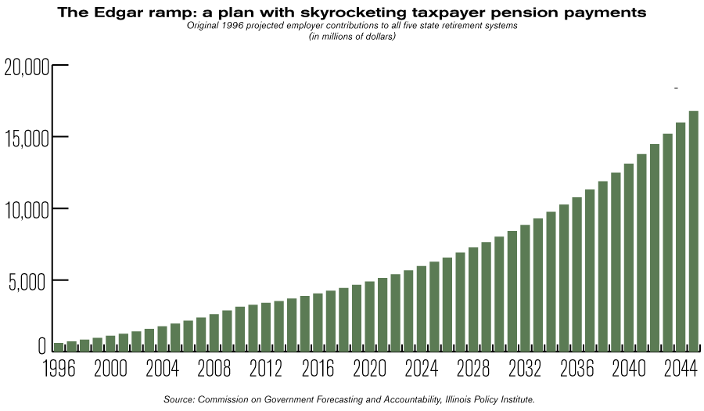
What were the problems?
3% COLA
Manipulating the last 4 years of salary
Kick it down the road
1994 “Reform” Plan: Edgar Ramp
Missed Payments: 2 years by Governor Bladgojevich

Slide 4
Defined Benefit Plan
Nationwide State Pensions: 2.5 trillion in debt
Political cycle: 2 year cycles
Get re-elected!
Help the people
Who will make the decisions down the road?

Slide 5
What about the 7.25% rate of return?
SURS = 8.2% over 20 years
Diversify the risk
We don’t think it’s a problem

Slide 6
Possible Solutions?
Lower the benefits
Reduce the 3% COLA
The annuity amount given to each employee (80%)
Problem: Court cases → unconstitutional

Slide 7
Putting the solution into perspective
The problem lies within multiple fields:
Politics, Legal, Accounting & Finance, and Actuarial Assumptions
Politics: Democrats and republicans have differing views
Legal: The courts disallow changes in benefits and certain actions
Accounting and finance: Investing and Unfunded ratio
Actuarial assumptions: Life expectancy, rate of returns

Slide 8
Retirement Tax
Defined Contribution Plan (401 k)
Lump Sum Payment
Service Tax
New Hires
Current Employees
Retired Employees
$
Our Solution

Slide 9
New Hires

Slide 10
Proposed 401k System
All new employees will be placed into defined contribution plans
Retirement funds will depend on portfolio performance
No benefits will be promised

Slide 11
Proposed 401k System
Financial Advisor Program
Hire advisors to monitor 401k portfolios
SURS meet initially with advisor
Yearly follow up to review goals

Slide 12
Proposed 401k System
Financial Advisor Program
390 SURS added monthly
13 financial advisors needed
Suggested 8% salary contribution per year, (7.6% State Match)

Slide 13
Per Employee 401k Projected Assets 40 Years (9.2% Return) | $341,405.85
Per Employee Contribution 40 Years | $285,695.83
Employee Net Assets | $55,710.02
Total SURS Employees 401k Projected Assets 40 | $312,707,962,517.82
Total SURS Employee 401k Liabilities 40 Years | $32,146,593,752.40
Cost of Advisor Program 40 Years | $70,042,140
Total State Liabilities 40 Years | $30,609,322,245.03

Slide 14
Why Switch to a 401k?
Illinois’ Perspective
Stops the “bleeding”
Unfunded liability stops growing

Slide 15
Why Switch to a 401k?
Illinois’ Perspective
No guaranteed benefits
Burden does not fall onto taxpayers

Slide 16
Why Switch to a 401k?
Retiree’s Perspective
Funds will be sufficient for retirement
Employees have a say in their investments
Yearly contribution will be equal to current pension obligation
Will receive “free” money through state matching

Slide 17
Current Employees

Slide 18
Service Tax
Based on Sales Tax Revenue of about $10.9 billion
Divided Sales Tax Revenue by Sales Tax % of 6.25%
Total Sales were about $174.5 billion
$174.5 billion X 0.50% (Service Tax) to gain a revenue of $872.8 billion

Slide 19
Retired Employees

Slide 20
Lump Sum
Average life expectancy= 85.45
Average annuity this year is $38,064
Based on age and how much annuity a person receives each year determines their present value lump sum to offer
7.25% is the assumed interest rate
Likelihood someone will take offer
75% payout to individuals

Slide 21
Age | Employees per age | Life Expectancy (85.45-Age) | Total Annuity Per Year | Assumed Interest Rate | Lump Sum Per Person | % Likelihood | Total Lump Sum | % Payout | Payout
62 | 1394 | 23.45 | $39,205.92 | 7.25% | $565,072.17 | 25% | $196,927,650.16 | 75% | $147,695,737.62
63 | 2095 | 22.45 | $40,382.10 | 7.25% | $566,833.98 | 24% | $285,004,124.64 | 75% | $213,753,093.48
64 | 2594 | 21.45 | $41,593.56 | 7.25% | $567,547.34 | 23% | $338,610,096.90 | 75% | $253,957,572.67
65 | 2866 | 20.45 | $42,841.37 | 7.25% | $567,100.97 | 22% | $357,568,501.62 | 75% | $268,176,376.21
66 | 2318 | 19.45 | $44,126.61 | 7.25% | $565,374.42 | 21% | $275,212,959.97 | 75% | $206,409,719.98
67 | 1964 | 18.45 | $45,450.41 | 7.25% | $562,237.46 | 20% | $220,846,872.97 | 75% | $165,635,154.73
68 | 1345 | 17.45 | $46,813.92 | 7.25% | $557,549.27 | 19% | $142,481,714.84 | 75% | $106,861,286.13
69 | 1855 | 16.45 | $48,218.34 | 7.25% | $551,157.67 | 18% | $184,031,545.54 | 75% | $138,023,659.16
70 | 2200 | 15.45 | $49,664.89 | 7.25% | $542,898.26 | 17% | $203,043,950.43 | 75% | $152,282,962.82
71 | 2200 | 14.45 | $51,154.83 | 7.25% | $532,593.50 | 16% | $187,472,912.28 | 75% | $140,604,684.21
72 | 2200 | 13.45 | $52,689.48 | 7.25% | $520,051.70 | 15% | $171,617,059.86 | 75% | $128,712,794.90
73 | 2200 | 12.45 | $54,270.16 | 7.25% | $505,065.97 | 14% | $155,560,317.68 | 75% | $116,670,238.26
74 | 2200 | 11.45 | $55,898.27 | 7.25% | $487,413.09 | 13% | $139,400,142.79 | 75% | $104,550,107.09
75 | 2200 | 10.45 | $57,575.22 | 7.25% | $466,852.27 | 12% | $123,248,998.80 | 75% | $92,436,749.10
76 | 2200 | 9.45 | $59,302.47 | 7.25% | $443,123.84 | 11% | $107,235,969.85 | 75% | $80,426,977.38
77 | 2200 | 8.45 | $61,081.55 | 7.25% | $415,947.85 | 10% | $91,508,526.82 | 75% | $68,631,395.11
78 | 2200 | 7.45 | $62,913.99 | 7.25% | $385,022.52 | 9% | $76,234,459.42 | 75% | $57,175,844.57
79 | 2200 | 6.45 | $64,801.41 | 7.25% | $350,022.66 | 8% | $61,603,988.67 | 75% | $46,202,991.51
80 | 2200 | 5.45 | $66,745.45 | 7.25% | $310,597.89 | 7% | $47,832,075.67 | 75% | $35,874,056.75
81 | 2200 | 4.45 | $68,747.82 | 7.25% | $266,370.79 | 6% | $35,160,943.86 | 75% | $26,370,707.90
82 | 2200 | 3.45 | $70,810.25 | 7.25% | $216,934.85 | 5% | $23,862,833.59 | 75% | $17,897,125.20
83 | 2200 | 2.45 | $72,934.56 | 7.25% | $161,852.37 | 4% | $14,243,009.00 | 75% | $10,682,256.75
84 | 2200 | 1.45 | $75,122.60 | 7.25% | $100,652.11 | 3% | $6,643,039.39 | 75% | $4,982,279.54
85 | 2199 | 0.45 | $77,376.27 | 7.25% | $32,826.79 | 2% | $1,443,722.36 | 75% | $1,082,791.77

Slide 22
Total Lump Sum
Total Lump Sum: $2,585,096,562.83
Liability Reduction: $3,231,370,703.54
Amount Saved: 646,274,140.70

Slide 23
Retirement Income Tax
Illinois only 1 of 3 states not currently taxing retirement income
2015 retirement income valued at $48.2 billion
Foreseeing retirement income tax as unfavorable amongst retirees
Assuming 20% of retirement income filers emigrate IL
2% retirement income tax rate
$771.9 million retirement income tax revenue

Slide 24
Financial Summary

Slide 25
Projected Income
Required contribution from current pension employees
Service Tax Revenue
Retirement Tax Revenue

Slide 26
Projected Expenses
Lump sum payments (Year 1)
State 401k matching (every year)
Financial Advisor Salary (every year)
Annuity payouts to current retirees (every year)

Slide 27
Yearly Assets/Liabilities Calculation
Assets
Current Market Assets
Service Tax Revenue
Retirement Tax Revenue
Required Contribution by current pension members
Interest on market investments
Lump Sum Payments
Retiree Annuity Payments
401 k matching
401 k advisors
= Next Year Market Assets
Liabilities
Current Total Liabilities
Accruing benefits for current employees
Lump Sum Payments
Deceased Employees
Annuity Payouts for retired employees
=Next Year Total Liabilities

Slide 28
Our solution: 7 years
Year | Net Assets (Market) | Accrued Liability | Unfunded Liability
2014 | $17,391,300,000.00 | $37,429,950,000.00 | -$20,038,650,000.00
2015 | $16,263,891,071.25 | $32,783,990,359.19 | -$16,520,099,287.93
2016 | $17,858,414,482.19 | $31,403,836,903.91 | -$13,545,422,421.72
2017 | $19,603,515,691.92 | $30,061,459,840.77 | -$10,457,944,148.85
2018 | $21,514,201,928.85 | $28,760,369,588.02 | -$7,246,167,659.17
2019 | $23,606,855,476.51 | $27,504,253,236.89 | -$3,897,397,760.37
2020 | $25,899,352,773.14 | $26,296,981,993.90 | -$397,629,220.76
2021 | $28,411,193,529.95 | $25,142,618,910.71 | $3,268,574,619.25

Slide 29
Importance of Findings
Our plan solves one component of the crisis
This program can be used as a pilot for other programs
The basic outline can be applied to any state retirement system

Slide 30
Sources
http://www.rebootillinois.com/2015/05/13/editors-picks/kevin-hoffmanrebootillinois-com/out-of-state-illinois-pensions-by-the-numbers/37662/
https://www.ssa.gov/planners/lifeexpectancy.html
http://cgfa.ilga.gov/Upload/FinConditionILStateRetirementSysMar2016.pdf
http://www.bls.gov/news.release/cesan.nr0.htm
http://www.surs.com/pdfs/ann_rep/content/PDFS/COMP-FY2015.pdf
http://www.fool.com/retirement/general/2015/02/22/the-average-american-takes-social-security-at-this.aspx
http://www.chicagobusiness.com/article/20150904/NEWS02/150909878/state-of-illinois-continues-to-hire-despite-lack-of-budget
http://www.nytimes.com/2010/03/28/us/28taxes.html?_r=0
http://www.sale-tax.com/Illinois
http://www.revenue.state.il.us/AboutIdor/TaxStats/
http://www.bls.gov/oes/current/oes132052.htm
http://www.bls.gov/oes/current/oes132052.htm
http://www.illinoistax.org/app/webroot/userfiles/file/2014%20Research%20Reports/2014%2011%20IFPC%20Research%20Report.PDF
http://www.auditor.illinois.gov/Audit-Reports/Performance-Special-Multi/State-Actuary-Reports/2015-State-Actuary-Rpt-Full.pdf

Slide 31
Retirement Tax
Defined Contribution Plan (401 k)
Lump Sum Payment
Service Tax
New Hires
Current Employees
Retired Employees
$
Questions?

