Slide 1
Illinois State Pension Crisis 2016
Proposed Solutions
Mariam Sadek
Mark McNicholas
Miguel Aguilar
Elliott Igunbor

Slide 2
Contents
The Current Pension System
The Solution
Debt Management
Generating Income
Alleviating Public Outcry
Preventing Future Disasters
Notes:
Facts: the debt. Not enough income. Upset people. Corrupt employees. Problem: solution Organize topic sentences provide proof of corruption and other resources of funding. Bullet points sub points dollar figures year by year now vs then. Resulted in $$

Slide 3
The Current Pension System
Pension benefit payments based on end-of-career salary
Pension contributions based on fixed percentage of employee’s salary

Slide 4
The Current Pension System

Slide 5
The Current Pension System
Retirement benefits are unrelated to contributions.
Pension benefits are an unsustainable burden on the economy.

Slide 6
The problem?
The Current Pension System

Slide 7
The Current Pension System
Lack of connection between:
Annual contributions to the fund
Promised benefits upon retirement
Fund Management
Retirees 30+ years of service promised to receive average $2M
Resulting debt facing the state upwards of $300B
Notes:
make talking points.

Slide 8
The Current Pension System
Corruption in Management
Average Retirement Age & Duration immeasurable
Debt facing the state upwards of $300B
Notes:
make talking points.

Slide 9
The Current Pension System
Stop giving incentives to retire early because people are living longer, which means government retirees are collecting more retirement benefits for longer than in the past.

Slide 10
The Current Pension System
The workers can retire early then work else where and earn income while receiving the city retirement income.t

Slide 11
The Solution?
Debt Management
Generating Income
Alleviating Public Outcry
Preventing Future Disasters

Slide 12
Debt Management
Compose financially feasible plan:
Modify unreasonable expected returns on investment activity
Reinforce seriousness and patience required
Budget, prioritize, and reduce expenses
Engage in Responsible Investment Activity
Act Ethically and Empathetically
Notes:
make talking points. Create a financially feasible repayment plan
Immediately modify unrealistic expected returns on investment activity from 7% to a more realistic number of 4-4.5%
This will increase the projected amount of debt owed, and reinforce the seriousness and patience needed to fix this problem in the long-term.
Engage in responsible investment activity
Act Ethically
Act Empathetically

Slide 13
Generating Income
Legalize & Invest in Medical Cannabis:
Growing billion dollar industry
Commodity Investment
Many unexplored medical benefits
Tax
Implement tax on marijuana sales
Allocate funds to underfunded Pensions
Washington state cannabis sales reach $660M+
$126M in tax revenue
Notes:
Marijuana is a fast growing, billion dollar industry that is improving the economy in many cities in the US
Seriously consider the benefits of legalizing Marijuana as a commodity investment
Legalize and semi-monopolize the sale of business-to-business Marijuana in the city of Chicago (medical dispensaries, bakeries, other retailers)
All profits fund the underfunded public pensions
Allocate the income generated to the public pension funds in a discrete and regular manner.

Slide 14
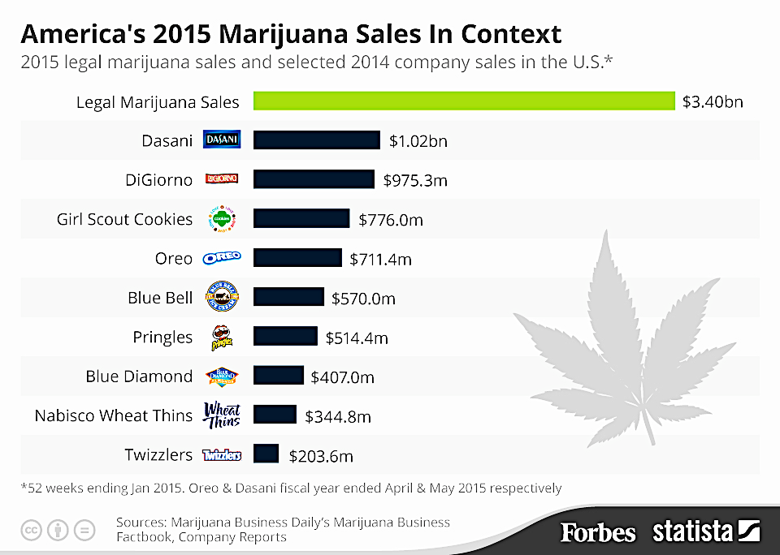
Generating Income

Slide 15
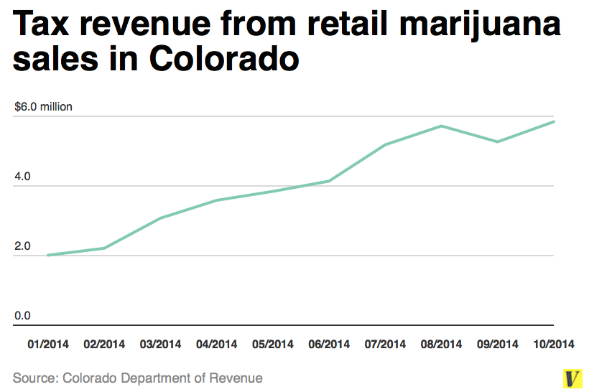
Generating Income

Slide 16
Generating Income
Medical Marijuana sales in Illinois:
8 licensed dispensaries in the past month
Illinois patients legally purchased $1.7M in November and December.
Proven Medical Benefits
Relief from disease symptoms, chronic pain
Therapeutic potential
Legalized in 23 states
Local municipalities benefit from tax revenues
Legalized in Pennsylvania yesterday afternoon
Notes:
Medical marijuana sales have begun in Illinois last month, with 8 licensed dispensaries opening in Marion, Mundelein, Canton, Quincy, Addison, North Aurora, Schaumburg and Ottawa. - One is also set to open in Chicago at 5001 N. Clark St. in the Andersonville neighborhood.
Marijuana has been proven to help with a wide range of mental and physical ailments including cancer, depression, pregnancy symptoms, eating disorders, anxiety, etc.
Marijuana has been legalized in 23 states and estimates suggest nearly $6.7 billion in sales this year alone.
By 2020 estimates are suggest nearly $22 billion in sales

Slide 17
Alleviating Public Outcry
Acknowledge impact on retirees:
Unexpected financial strain
Broken promises
Reduced buying power
Create awareness
State-wide campaign to promote care for elderly
Encourage and inspire millennials
Support from local celebrities
Sales & promotions
Support from local retailers
Notes:
Acknowledge the emotional impact of retirees facing this unexpected financial strain.
Create a state-wide campaign using popular social media and celebrated entities to promote caring for the elderly.
These campaigns will encourage millenials, and inspire caring for their grandparents and the elderly, regardless of how they feel about them. (comedic)
Request support from local celebrities, to share their experiences with their grandparents, while giving them their time and interest.
Reach out to popular retailers and pharmacies to endorse sales & promotions for products needed by the elderly, as their buying power diminishes

Slide 18
Preventing Future Disasters
New Jersey Eliminated part-time employees eligible for pension plan Rolled back expensive benefit increases approved in 2001 Increased employee contributions for health benefits | Illinois Give city workers a self-managed 401(k)-style retirement plan and Social-Security-like benefit Make retirement costs stable and predictable portion of Chicago’s budget Protect taxpayers from paying for increasing taxes to cover ever-growing pension short falls
Notes:
The Illinois Policy Institute has developed a comprehensive reform plan that aligns the structure of public-sector retirement with the private sector, while protecting what current workers have already earned.
The core of the Institute’s solution is a retirement plan that gives city workers a self-managed 401(k)-style retirement plan and a Social Security-like benefit. This allows their savings to grow with the market while providing a stable source of income each month.
The plan also makes retirement costs a stable and predictable portion of Chicago’s budget and helps prevent indiscriminate cuts to core government services due to rising pension costs. Finally, the Institute’s plan protects taxpayers from paying higher taxes to fund ever-growing pension shortfalls.
The Institute’s holistic pension reform plan is the only plan on the table that puts Chicago back on a path to financial security and aligns the structure of public-sector retirement with the private sector.

Slide 19
Preventing Future Disasters
Emphasize ethics in hiring process
Regular supervision of pension contributions
Shared responsibility and shared consequences
Create transparency in pension fund activity
Notes:
New Jersey eliminated par time employees eligible for pension plans. Prevent corrupt individuals from holding positions responsible for retirement plans/funds. - Prioritize ethics in the hiring process - Maintain supervision of regular pension contributions through shared responsibility and shared consequences.
Implement a clear and concise plan for public sector employees to better manage their pensions independently. - Encourage employees to require more transparency in pension fund activity from their employers
Create a campaign to educate and inspire millenials to consider their retirement and their retirement options at an early age.

Slide 20
Thank you

